Slide 1
Automatic Room Light System

Slide 2
Aim:
To Implement An Automatic Room Light System

Slide 3
Components
Components needed for the Automatic Room Light System with bidirectional counter: Microcontroller board (e.g., Arduino Uno) Infrared sensor module Relay module Seven-segment display (optional, for bidirectional counter) Transistors (if required to drive the relay or display) Resistors and capacitors (as per circuit requirements) Connecting wires Power supply (if required)

Slide 4
Procedure
Procedure for the Automatic Room Light System with bidirectional counter: Gather all the required components mentioned earlier. Design the circuit diagram based on the project requirements and component connections. Ensure proper connections between the microcontroller, Iconnect the components on a breadboard or PCB according to the circuit diagram. Upload the provided code to the microcontroller (e.g., Arduino Uno) using the Arduino IDE or compatible software. Power up the circuit using a suitable power supply. Test the IR sensor by sending signals using a compatible IR remote control. Verify that the counter increments or decrements correctly based on the received signals.

Slide 5
Ensure that the relay module is functioning correctly by observing the state of the relay and the connected lights. The lights should turn on when the counter is odd and turn off when the counter is even.
If using a seven-segment display for the bidirectional counter, ensure that the display segments are properly controlled based on the counter value. Modify the displayCounter() function in the code to reflect the correct segment control logic for your specific display.
Once the functionality is confirmed, mount the circuit in a suitable enclosure or housing. Place the IR sensor in an appropriate location within the room to capture the signals effectively.

Slide 6
Connect the lights to the relay output for automatic control. Conduct thorough testing of the entire system to ensure proper operation and reliability. Make any necessary adjustments or optimizations based on the test results. Document the project, including the circuit diagram, component list, code, and any specific instructions or considerations for future reference.

Slide 7
Description
Description of the project: The Automatic Room Light System with bidirectional counter is designed to automatically control the room lights based on the received infrared (IR) signals and keep track of the count in a bidirectional manner. The project utilizes a microcontroller, IR sensor, relay module, and optionally a seven-segment display.
The IR sensor detects the IR signals emitted by a compatible IR remote control. Each time a signal is received, the counter variable increments or decrements accordingly. The counter represents the state of the lights, where an odd count turns the lights on, and an even count turns the lights off.

Slide 8
The relay module is used to control the room lights. When the counter indicates an odd count, the relay is triggered to turn on the lights. Similarly, when the counter indicates an even count, the relay is triggered to turn off the lights.
Optionally, a seven-segment display can be used to show the current count. The display segments are controlled based on the counter value, providing a visual representation of the count.
The project combines hardware components, circuitry, and software programming to achieve the automatic control of room lights based on received IR signals. It offers the convenience of hands-free lighting control and the ability to keep track of the count bidirectionally.

Slide 9
Ensure to follow safety precautions while working with electrical components and circuits. Modify the project as needed to meet your specific requirements and ensure reliable operation.

Slide 10
Code:
Code for the Automatic Room Light System with bidirectional counter:#include <Irremote.h> // Library for IR sensor #define IR_PIN 2 // Pin connected to the IR sensor #define RELAY_PIN 3 // Pin connected to the relay module #define DISPLAY_PIN_A 4 // Pin connected to display segment A #define DISPLAY_PIN_B 5 // Pin connected to display segment B // … Continue with other segment pins int counter = 0; // Counter variable for bidirectional count Irrecv irReceiver(IR_PIN); decode_results irResults; void setup() { pinMode(RELAY_PIN, OUTPUT); // Set display segment pins as OUTPUT pinMode(DISPLAY_PIN_A, OUTPUT); pinMode(DISPLAY_PIN_B, OUTPUT);

Slide 11
// … Set other segment pins as OUTPUT irReceiver.enableIRIn(); // Enable IR receiver } void loop() { // Check for IR signal reception if (irReceiver.decode(&irResults)) { // Increment counter on each received signal counter++; displayCounter(); delay(500); // Delay to avoid multiple counts for a single signal irReceiver.resume(); // Continue to listen for IR signals } // Check counter value for light control if (counter % 2 == 0) { digitalWrite(RELAY_PIN, LOW); // Turn off the lights

Slide 12
} else { digitalWrite(RELAY_PIN, HIGH); // Turn on the lights } } // Function to display the counter value on the 7-segment display void displayCounter() { // Write logic to control the display segments based on the counter value // Use the segment pins (DISPLAY_PIN_A, DISPLAY_PIN_B, etc.) to drive the display // Refer to the datasheet or documentation of your specific display for pin connections and segment control logic }

Slide 13
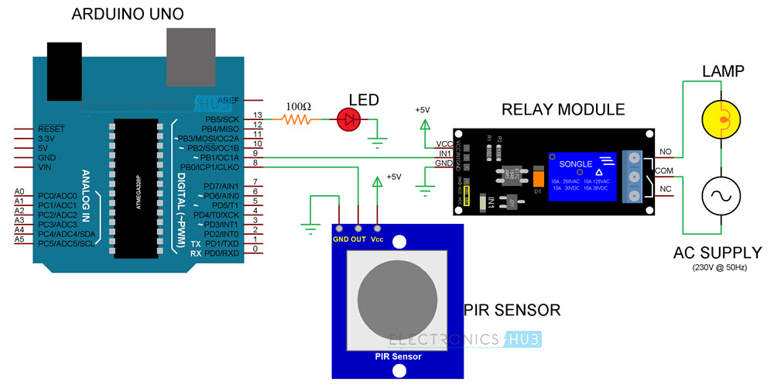
Circuit diagram:

Slide 14
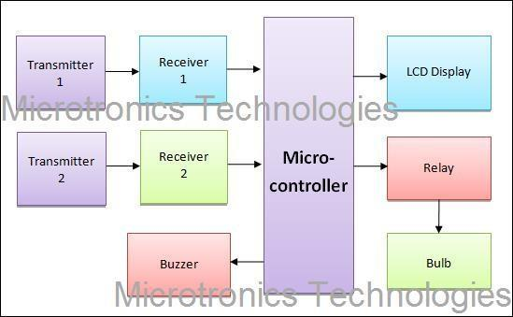

Slide 15
Conclusion:
The above project is based on Automation Room Light System.

